Slide 1


Slide 2
Agile’s 12 principles
Highest priority is customer satisfaction
Welcome changing requirements
Deliver working software frequently
Business people, Analysts and developers MUST work together DAILY throughout the project
Build projects around motivated individuals and trust them to get the job done
Face-to-face conversations is the most effective way to convey information……….

Slide 3
Agile’s 12 principles (continued)
Working software is the PRIMARY measure of progress
Agile processes support sustainable development. The Team should be able to maintain a constant pace indefinitely.
Continuous attention to technical excellence and good design
Simplicity is essential
The best work emerges from self-organizing teams
Regular reflection to tune and adjust the behavior of the team

Slide 4
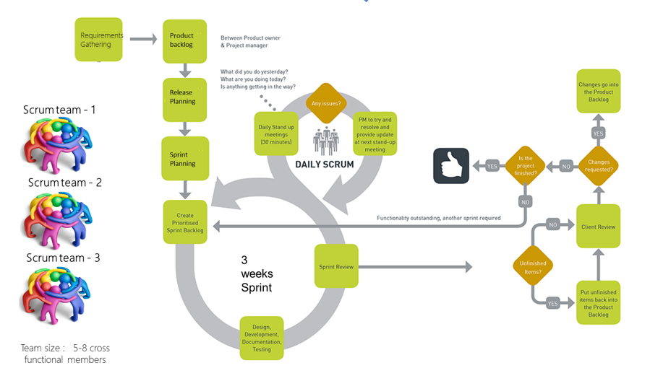
Scrum Process Flow

Slide 5
Our Scrum Teams
Our Scrum teams will…
Cross-functional
Have 5-10 team members
1 Scrum Master
1 Product Owner
1 FT Tester Role (supplemented by offshore)
2-3 FT Analyst Role
3-5 FT Developers
Scrum teams are permanent and should NOT be changed

Slide 6
Roles and Responsibilities
Stakeholder role
Managers and Director are designated Stakeholders along with Business Partners
Attend Scrum of Scrums +
Designate strategic direction and priorities
Not allowed to attend daily scrum meetings, planning nor retrospective meetings
Invited to Sprint Demo

Slide 7
Roles and Responsibilities
Continues…
Scrum Team Product owner
Define the features of the product
Decide on release content
Be responsible for the profitability of the product (ROI – return on investment)
Prioritize features according to market value
Adjust features and priority every iteration, as needed
Accept or reject work results
Coordinates and facilitates Sprint planning meeting and Demo with the Scrum Master

Slide 8
Roles and Responsibilities
Continues…
Team Scrum Master
Represents management to the project
Responsible for enacting Scrum values and practices within the team
Removes impediments
Ensure that the team is fully functional and productive
Enable close cooperation across all roles and functions
Shield the team from external interferences
Works with Product Owner on grooming backlog and planning
Coordinates and facilitates Daily Scrum and Sprint Retrospective
Coordinates and facilitates Sprint planning meeting and Demo with the Product Owner

Slide 9
Roles and Responsibilities
Continues…
Team Members
Self-disciplined
Team makes decisions collaboratively
Cooperative development – role sharing
Cross-functional
Accountable
Responsible for updating TFS and MS Project Hours (Estimates, Actuals, Capacity)
Analysts
Role can be any associate – Developer, Tester, Analyst
Requirements should be 80% acquired before associated Story/Tasks assigned to Sprint
Requirements documentation completed before END of Sprint
9
Notes:
Categories of Insurance based on the type of Insured.

Slide 10
Roles and Responsibilities
Continues…
Tester/Developer
Role can be any associate – Developer, Tester, Analyst
Testing is continuous
Unit testing Bugs do not accumulate – they are not deferred to the end of the dev cycle
Quality is EVERYONE’s responsibility
Use Requirements and Acceptance Criteria to deliver each increment of the product
Sets User Story to resolved when code is checked in
Task Planning and hour tracking
Ensuring good implementations
Helps determine workload and capacity
Helps testers when necessary
10

Slide 11
Meeting/Events
Scrum meetings
Daily Scrum Meeting
Sprint Planning Meeting
Sprint Demo
Sprint Retrospective
Daily Scrum Meeting
What is the purpose of these meetings?
Accountability
Each team member takes a turn going over what they accomplished yesterday and what they will be doing today
Review team progress
Report impediments
11

Slide 12
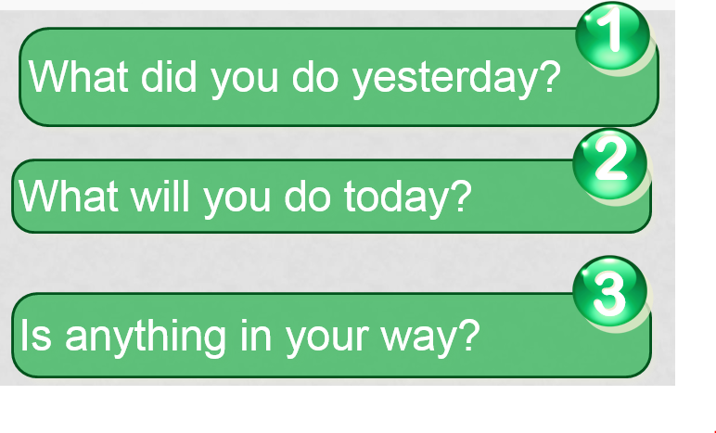
Daily Scrum Meetings
Who: Each scrum team, all members (mandatory)
When: Decided by Scrum team
How long: 15 mins
Daily Scrum Meetings Everyone answers 3 questions
These are not status for the Scrum Master
They are commitments in front of peers
12

Slide 13
Sprint planning
Product Owner and Scrum Master should groom backlog and pre-plan each and every sprint
Scrum team manages sprint backlog and determines sprint goals
Breaks sprint backlog item into User Stories
Each user story MUST be delivered within a sprint
Determines estimates, story points, capacity and assignments
13

Slide 14
The Sprint Demo
Upon sprint completion, project Team presents what it accomplished during the sprint
Informal
2-hour prep time rule
No slides
Whole team participates
14

Slide 15
Sprint retrospective
Periodically take a look at what is and is not working
Typically 15–30 minutes
Done after every sprint
Whole team participates
Scrum Master
Product owner
Team
Each Sprint planning meeting can start with a prior Sprint Retrospective
15

Slide 16
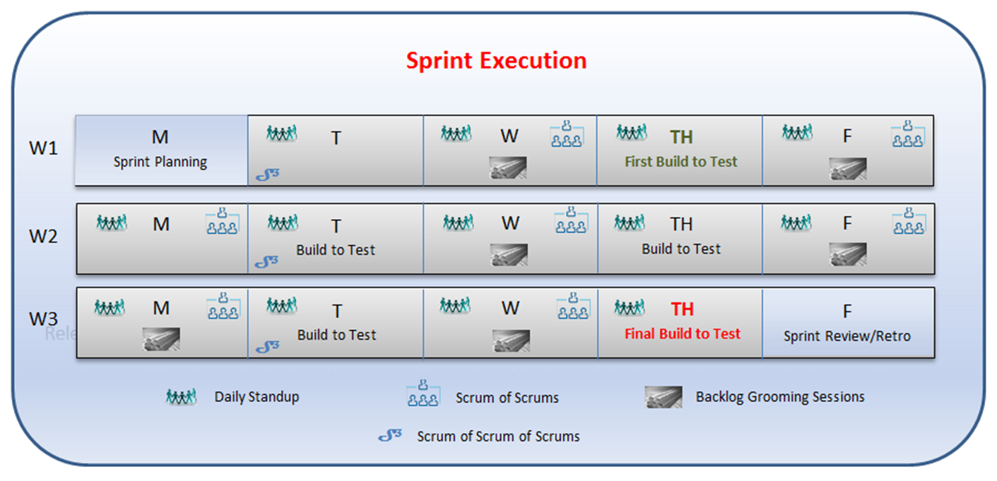
Sprint Schedule

Slide 17
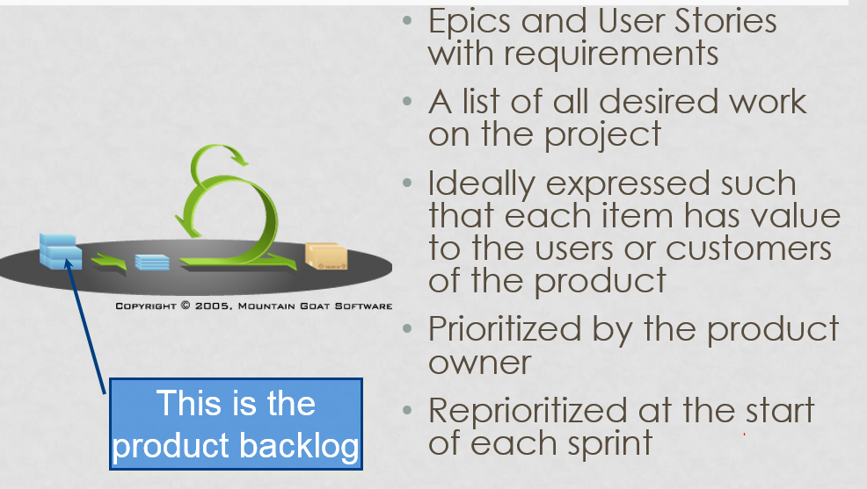
Artifacts
Product backlog
17

Slide 18
Sprint backlog
During the Sprint Planning meeting, using priority and dependencies,
Product Backlog is reviewed and discussed
Features/User Stories are selected for Sprint
Sprint Backlog is created
Tasks are added to User Stories in Sprint Backlog
18

Slide 19
Definition of Ready
The Definition of Ready is a set of agreements that lets everyone know when something is ready to go into a sprint
The Definition of Ready for User Stories is:
User Story defined
User Story Acceptance Criteria defined
User Story dependencies identified
Requirements are at least 80% complete
Story Points Assigned
19
Notes:
Example of a binder: Until Joe's credit and past insurance history could be researched, his agent gave him a binder for 10 days. The binder gave Joe all the same coverage's and rights as he would have with a regular insurance policy, but would automatically cease after the 10 days.

Slide 20
Definition of done
Agreement between Product Owner(s) and Scrum Master(s) that acceptance criteria has been met
Code complete, functionally tested (not by developer who coded it), critical bugs found and fixed
20
Notes:
Example of a binder: Until Joe's credit and past insurance history could be researched, his agent gave him a binder for 10 days. The binder gave Joe all the same coverage's and rights as he would have with a regular insurance policy, but would automatically cease after the 10 days.

Slide 21
Test plans and Testing
Coverage's in Auto
Test plans are created by the VM Test Team and reviewed by the scrum team
Functional testing happens within the Sprint by VM team
Testing Bugs added to Product backlog and groomed by Product Owners

Slide 22
Questions?

